Slide 1

Simon
by:
Dunni Adenuga
Brooke Bullek
Bobby Cao
Andrew Capuano

Slide 2
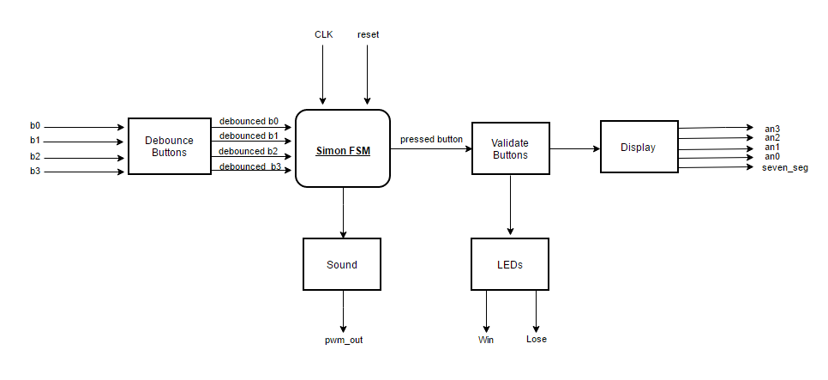
Design: Block Diagram
Notes:
Andrew
Sequence module?

Slide 3
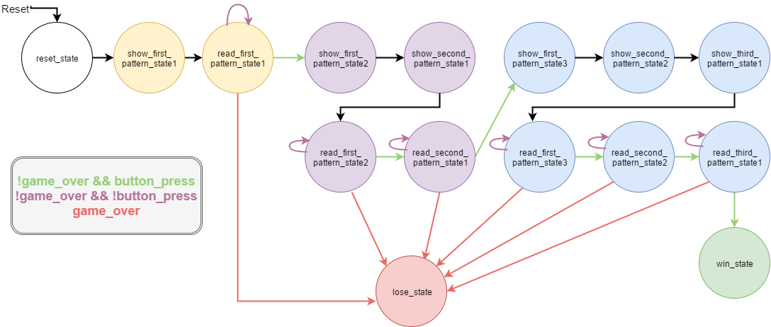
Design: State Transition Diagram
Notes:
Brooke

Slide 4
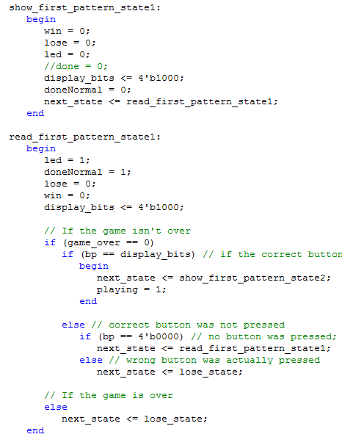
Module: Simon FSM
Our top-level Module
Contains the Game Logic
Show Pattern and Read Pattern States
The player goes through Win or Lose State
This module received inputs from button module and clock
Outputs to display and sound module
Notes:
Bobby
This is the comprehensive module that we started with. iit contains all of our game logic.
Code on the right is an example of our main logic.
There are show states show the pattern on the 7-seg display via display_bits which uses 1 hot encoding . What we see here the distplay bit is set to 1000 which is the first display lights up
Then it goes to the related read state where if the users presses the correct button it goes to the next show pattern state and increments the current round you are in
If the user presses the wrong button it goes to the lose state
This is basically our main module it gets inputs from our debounced buttons and it outputs to the display, and sound module. It uses the validates buttons module to check if the if the buttons and the display correlate

Slide 5
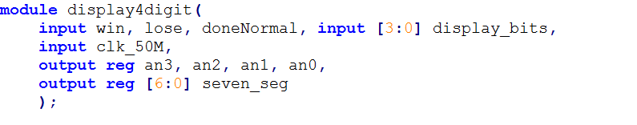
Module: Display
State of FSM determines what is shown on 7-segment display
During play, “0” is placed at a specific position (anode)
Win state displays “gOOd” while lose displays “LOSE”
Uses persistence of vision
Notes:
Dunni

Slide 6
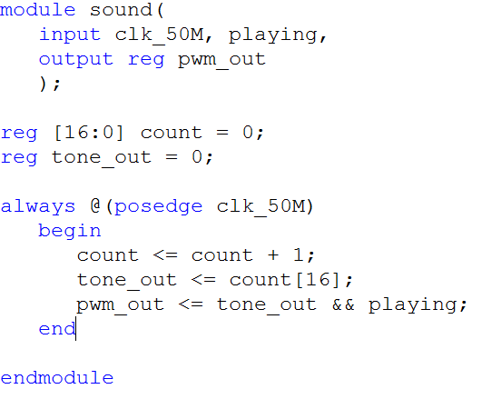
Module: Sound
Sets the given 50 MHz clock to run at approx. 440Hz
2^17 bit counter register is used (50 MHz / 440 Hz)
Playing input from FSM
Set inside each read state whenever a correct button is pressed
Outputs an audible tone if playing and the MSB of count are set
Notes:
Brooke

Slide 7
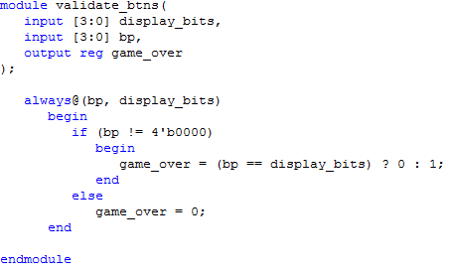
Module: Buttons (Validate and Debounce)
Once buttons are debounced, must be validated
Check to see whether 4 bit input is equivalent to the 4 bits displayed
If so, the game is not over, otherwise the user enters the game over state
Notes:
Andrew
Debounce_buttons module:
Very similar to lab but now with 4 buttons inputted
We called the debouncer from lab 4 times to get 4 clean buttons
Outputted a 4 bit register called bp (“button pressed”) which was done by a one-hot encoding
Used an always @ loop to say that bp should = whichever clean button was pressed

Slide 8
Challenges We Overcame
Modifying our old design
Verilog Warnings
Combinatorial loops
Latches
Timing button presses
Adding sound
Notes:
Bobby
We overcame a number of challenges
Our initial idea was having a design where we could intuitively add more rounds
but this proved to be really difficult so we scrapped that design and chose a new design that was not as intuitive but it works.
Verilog warning:
WE had a lot of problems with verilog warnings that messed up the logic of our code. For example the win led to on before the user finsihed all the rounds
. We had problems with combinatorial loops and latches which took a good amount of time to figure out. WE just had to be consistent with our variable placement
Timing button presses was an issues because we would have the player press the button for about 1 second and of course that is difficult to keep consistent.
So we added a sound and that indicated to the player how long to press the button
Adding sound was a bit difficult but it took a good amount of google searches and forums to implement the sound with our clock.

Slide 9
Future Work
Improved FSM Design
Keep track of rounds, score
VGA module
for bigger display
Random module
Position on display is randomly selected
Harder mode with more rounds
Choice to play with switches and LEDs
Different tones for button presses
Timer module
Notes:
Dunni

Slide 10
Innovative Aspects
Sound synchronized with button presses
Control of four displays
Movement of a marker across the display to show the sequence to the user
Output of users game status - “GOOD” or “LOSE”
Slowing down clock frequency to make game more intuitive
Notes:
Andrew

Slide 11
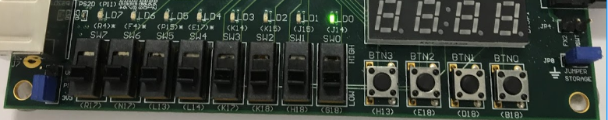
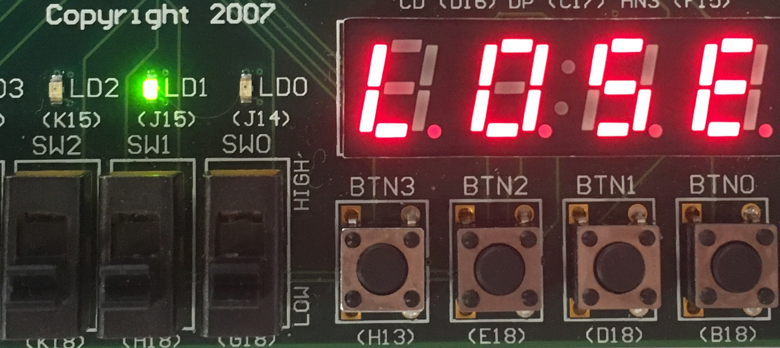
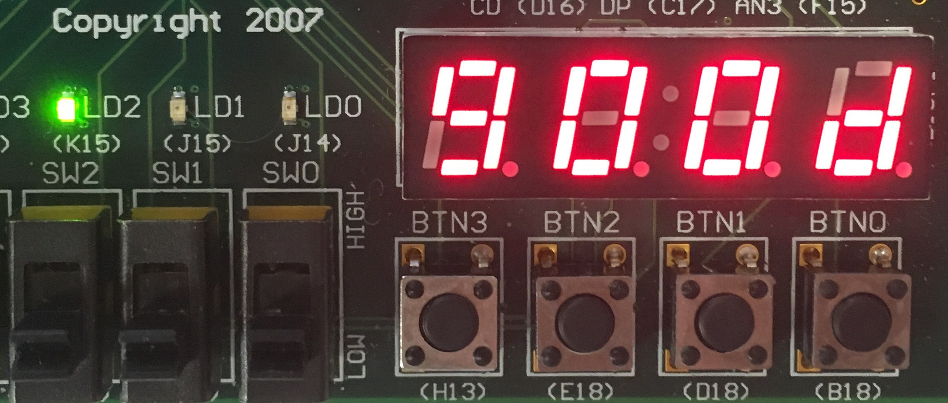
FPGA Board Overview
Win
LED
Lose LED
In-Game
LED
Display, shows a 0
Button that corresponds to the display
Reset Switch.
(Move up and down to reset the game)
Notes:
Bobby
Explain layout of the board - positioning of LEDs, reset switch and buttons
7-Segment display outputs “good” if the user correctly repeats the full 3 step sequence or outputs “lose” if user incorrectly input the sequence

Slide 12
Demo

